Slide 1

PLANT TEMPERATURE
SERVERLESS COMPUTING FOR IOT
SUBIMITTED TO
PROF Vittorio SCARANO
SUPERVISOR
Giuseppe D'AMBROSIO
SUBMITTED BY
AREEB ULLAH KHAN

Slide 2
PROBLEM AREA
Temperature measurement and analysis is playing a key role in metal processing, as well as monitoring.
If the temperature measurement information is not correct, then it can affect quality of the final product, as well as endanger workplace security.

Slide 3
How Temperature Measurement is Important in Different Industries?
An accurate determination of temperature, or the measure of hot or cold, is an important factor in many industries as follows:
Food and Beverage Processing:
Temperature is one of the important factors to consider during the bulk production of food items
Beverage industry Temperature plays a vital role in deciding the quality of the final product. During the wine making or brewing process, the ambient temperature, as .

Slide 4
How Temperature Measurement is Important in Different Industries?
Plastic Production Temperature plays an important role in the plastic industry. During the manufacturing stages, for example thermoforming, or injection molding, several temperature ranges needs to be monitored to ensure a high product quality.
Metal Processing: Be it any type of metal process plant, temperature measurement is always high on the list for operational excellence. Temperature measurement and analysis is playing a key role in metal processing, as well as monitoring. If the temperature measurement information is not correct, then it can affect quality of the final product, as well as endanger workplace security.

Slide 5
PURPOSE
The purpose of this project is to observe temperature and monitor those values on an independent platform so we can get information about the plant temperature which save us from many issues.

Slide 6
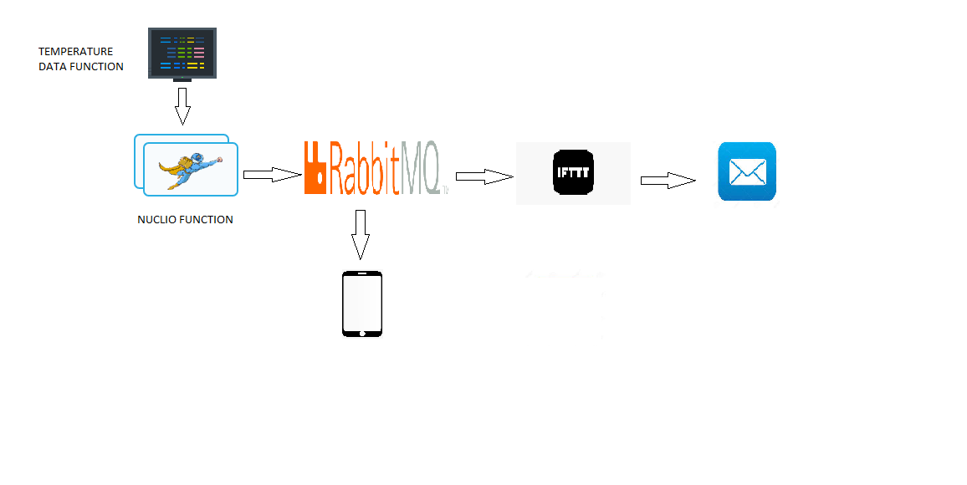
ARCHITECTURE DIAGRAM

Slide 7
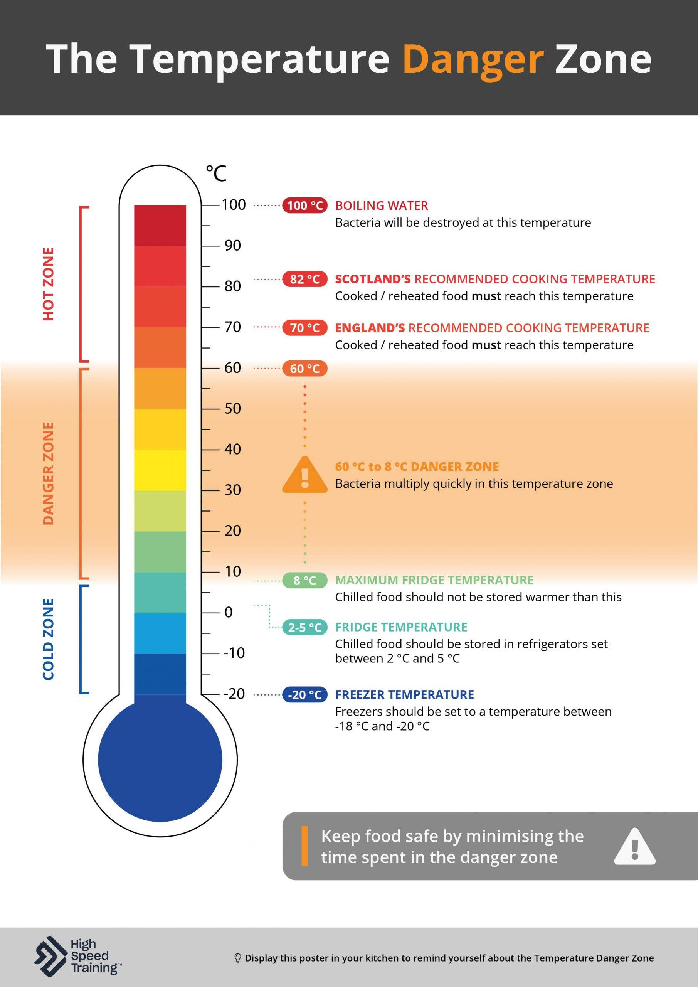
Temperature requirements of some industrial processes

Slide 8
SERVICES
Docker
Docker is an open platform for developing, shipping, and running applications. Docker enables you to separate your applications from your infrastructure so you can deliver software quickly. With Docker, you can manage your infrastructure in the same ways you manage your applications.
RabbitMQ
RabbitMQ is an open-source message-broker software which implements AMQP and has since been extended with a plug-in architecture to support MQTT and other protocols.
Node.js
Node.js is an open-source, cross-platform, back-end JavaScript runtime environment that runs on the V8 engine and executes JavaScript code outside a web browser

Slide 9
SERVICES
NUCLIO DASHBOARD
Nuclio is a high-performance "serverless" framework focused on data, I/O, and compute intensive workloads, Nuclio is extremely fast a single function instance can process hundreds of thousands of HTTP requests or data records per second.
MQTIZER
MQTT stands for Message Queue Telemetry Transport. It is a publish/subscribe, extremely simplistic and lightweight messaging protocol, devised for constrained devices and low-bandwidth, high-latency or unreliable networks.
IFTTT
If This, Then That is a private commercial company that runs services that allow a user to program a response to events in the world

Slide 10
LIBRARIES
The Advanced Message Queuing Protocol (AMQP) is an open standard for passing business messages between applications or organizations.
Requests allows you to send HTTP/1.1 requests extremely easily. There’s no need to manually add query strings to your URLs, or to form-encode your POST data.
MQTT is a lightweight publish-subscribe mode messaging protocol designed for IoT applications in low-bandwidth and unstable network environments. MQTT is based on the publish/subscribe paradigm and works on the TCP/IP protocol family.

Slide 11
IMPLEMENTATION
DOCKER
We install docker desktop on windows
NUCLIO :
After Installing docker then we install Nuclio serverless platform by using the docker command in command prompt.
RABBIT MQ :
We install RabbitMQ by using the given Docker command in command prompt.
IFTTT :
We make account and make applets on IFTTT webhooks and then we create events on IFTTT applets through webhooks.

Slide 12
IMPLEMENTATION
To generate the queues on RabbitMQ we deploy the given function on Nuclio dashboard by setting IP and triggers.
The deployed function on Nuclio dashboard will generate queues on RabbitMQ of temperature data function.
MQTIZER android application display the data on Smartphone by setup the IP that will generate messages on phone.
IFTTT create events on applets through webhooks and sending email.

Slide 13
THANK YOU

